Slide 1
The list of matching modules

Slide 2
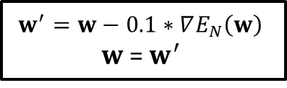

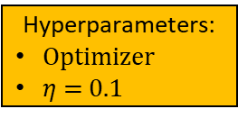
The vanilla backward operation
Hyperparameters:
Optimizer
$η$ = 0.1
Calculate gradient $∇E_{N}\left(w\right)$
$$w^{′}=w−0.1∗∇E_{N}\left(w\right)$$
$w$ = $w^{′}$

Slide 3







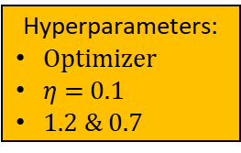
The backward operation with the adaptable $η$ arrangement
Hyperparameters:
Optimizer
$η$ = 0.1
1.2 & 0.7
$$η$$
Store w
Calculate gradient $∇E_{N}\left(w\right)$
$$w^{′}=w−η∗∇E_{N}\left(w\right)$$
$restore w \text{\&} η=η$*0.7
forward operation
false
$$E_{N}\left(w′\right)≤E_{N}\left(w\right)$$
true
$w=w^{′}$ & $η=η$*1.2

Slide 4
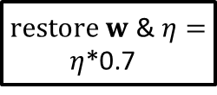



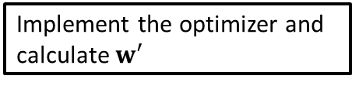
The backward operation with the adaptable $η$ arrangement
Hyperparameters:
Optimizer
$η$ = 0.1
1.2 & 0.7
$$η$$
Store w
Implement the optimizer and calculate $w′$
$restore w \text{\&} η=η$*0.7
forward operation
false
$$E_{N}\left(w′\right)≤E_{N}\left(w\right)$$
true
$w=w^{′}$ &
$η=η$*1.2

Slide 5
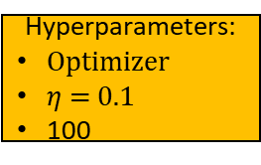

The vanilla matching module
Hyperparameters:
Optimizer
$η$ = 0.1
100
i = 1
$$η$$
i++
i >= 100
Backward
operation
Forward
operation
false
true

Slide 6
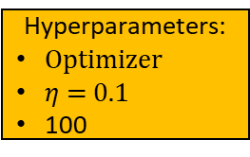

The matching module indicating either an acceptable SLFN or an unacceptable SLFN
Hyperparameters:
Optimizer
$η$ = 0.1
100
The acceptability is determined by the learning goal
$$η$$
i = 1
Forward
operation
i++
false
i >= 100
Learning goal
Backward operation
false
true
true
B
Unacceptable SLFN
Acceptable SLFN
A
6

Slide 7


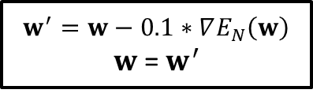


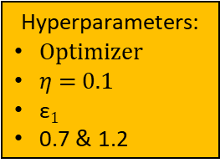
The matching module indicating either an acceptable SLFN or an unacceptable SLFN
Hyperparameters:
Optimizer
$η$ = 0.1
$\text{ε}1$
0.7 & 1.2
The acceptability is determined by the learning goal
$$η$$
forward operation
A
true
Learning goal
false
Store w
Implement the optimizer and calculate $w′$
forward operation
Restore w & $0.7η→η$
$$E_{N}\left(w′\right)≤EN\left(w\right)$$
$w^{′}→w,$ $$1.2η→η$$
true
false
ture
$$η>\text{ε}1$$
false
B

Slide 8




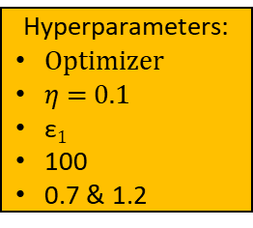
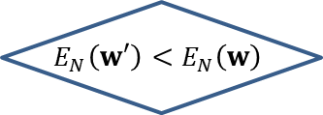
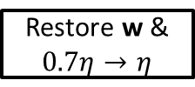


The matching module indicating either an acceptable SLFN or an unacceptable SLFN
i = 1
$$η$$
forward operation
true
Learning goal
A
false
Hyperparameters:
Optimizer
$η$ = 0.1
$\text{ε}1$
100
0.7 & 1.2
Store w
Calculate $∇E_{N}\left(w\right)$
i++
$$w^{′}=w−η ∇E_{N}\left(w\right)$$
The acceptability is determined by the learning goal
forward operation
$$E_{N}\left(w′\right)<E_{N}\left(w\right)$$
false
Restore w & $0.7η→η$
$w^{′}→w$, $$1.2η→η$$
$$\text{i}≥\text{100}$$
true
false
true
true
$$η>\text{ε}1$$
false
B

Slide 9
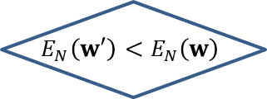
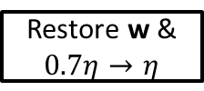


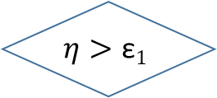

The matching module indicating either an acceptable SLFN or an unacceptable SLFN
$$\text{i}=\text{1}$$
$$η$$
forward operation
true
Learning goal
A
false
Hyperparameters:
Optimizer
$η$ = 0.1
$\text{ε}1$
100
0.7 & 1.2
Store w
$$\text{Implement} \text{the} \text{optimizer} \text{and} \text{calculate} w′$$
i++
forward operation
The acceptability is determined by the learning goal
false
$$E_{N}\left(w′\right)<E_{N}\left(w\right)$$
Restore w & $0.7η→η$
true
$w^{′}→w,$ $$1.2η→η$$
$$\text{i}≥\text{100}$$
false
true
true
$$η>\text{ε}1$$
false
B

